Slide 1
Best Practice
1) Write programs for people, not computers
2) Let the computer do the work

Slide 2
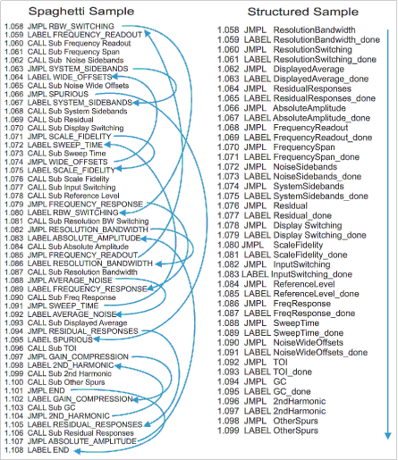
1) A program should not require its readers to hold more than a handful of facts in memory at once
Break programs up into easily understood functions
Don’t write spaghetti code
Notes:
Take several aspects of human cognition into account: In particular, that
1) Human working memory is limited,
2) Human pattern matching abilities are finely tuned,
3) and human attention span is short.
This serves to make each piece of the program easier to understand in the same way that breaking up a scientific paper using sections and paragraphs makes it easier to read.

Slide 3
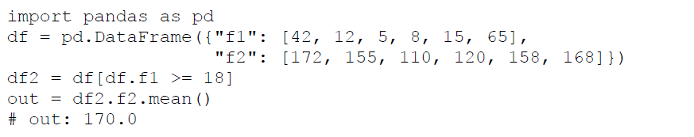
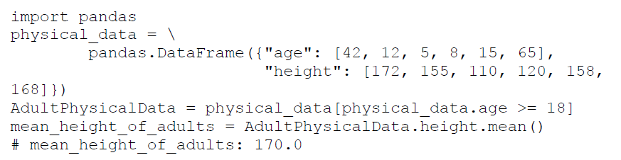
1) Make names consistent, distinctive, and meaningful
Notes:
Bad naming versus
Half good naming versus
Good naming

Slide 4
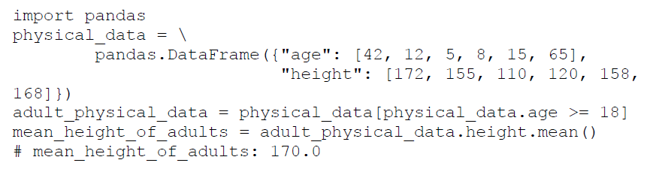
1) Make code style and formatting consistent
Use same indentation everywhere
Same capitalization
Notes:
If different parts of a scientific paper used different formatting and capitalization, it would make that paper more difficult to read. It’s the same with code.

Slide 5
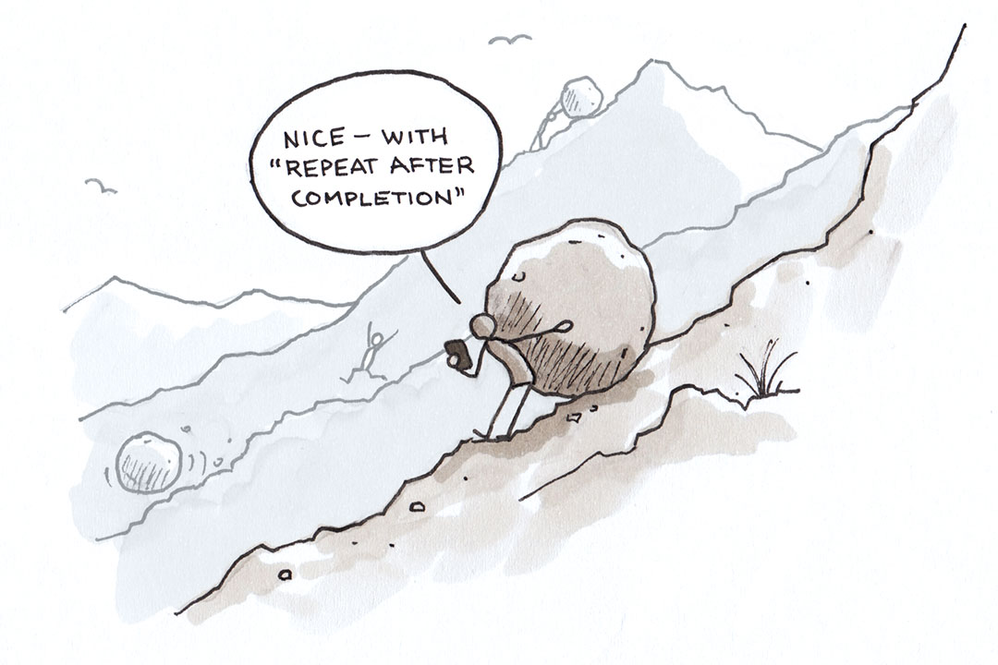
2) Make the computer repeat tasks

Slide 6
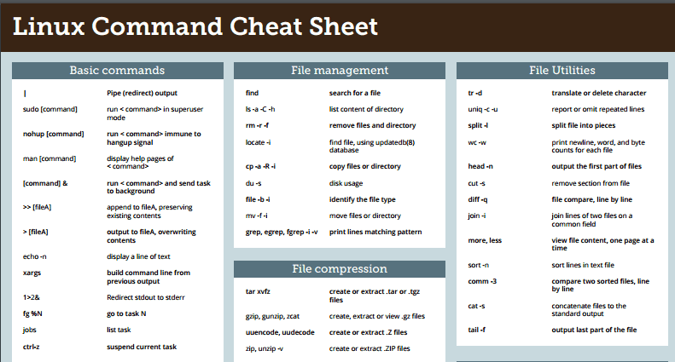
2) Save recent commands in a file for re-use

Slide 7
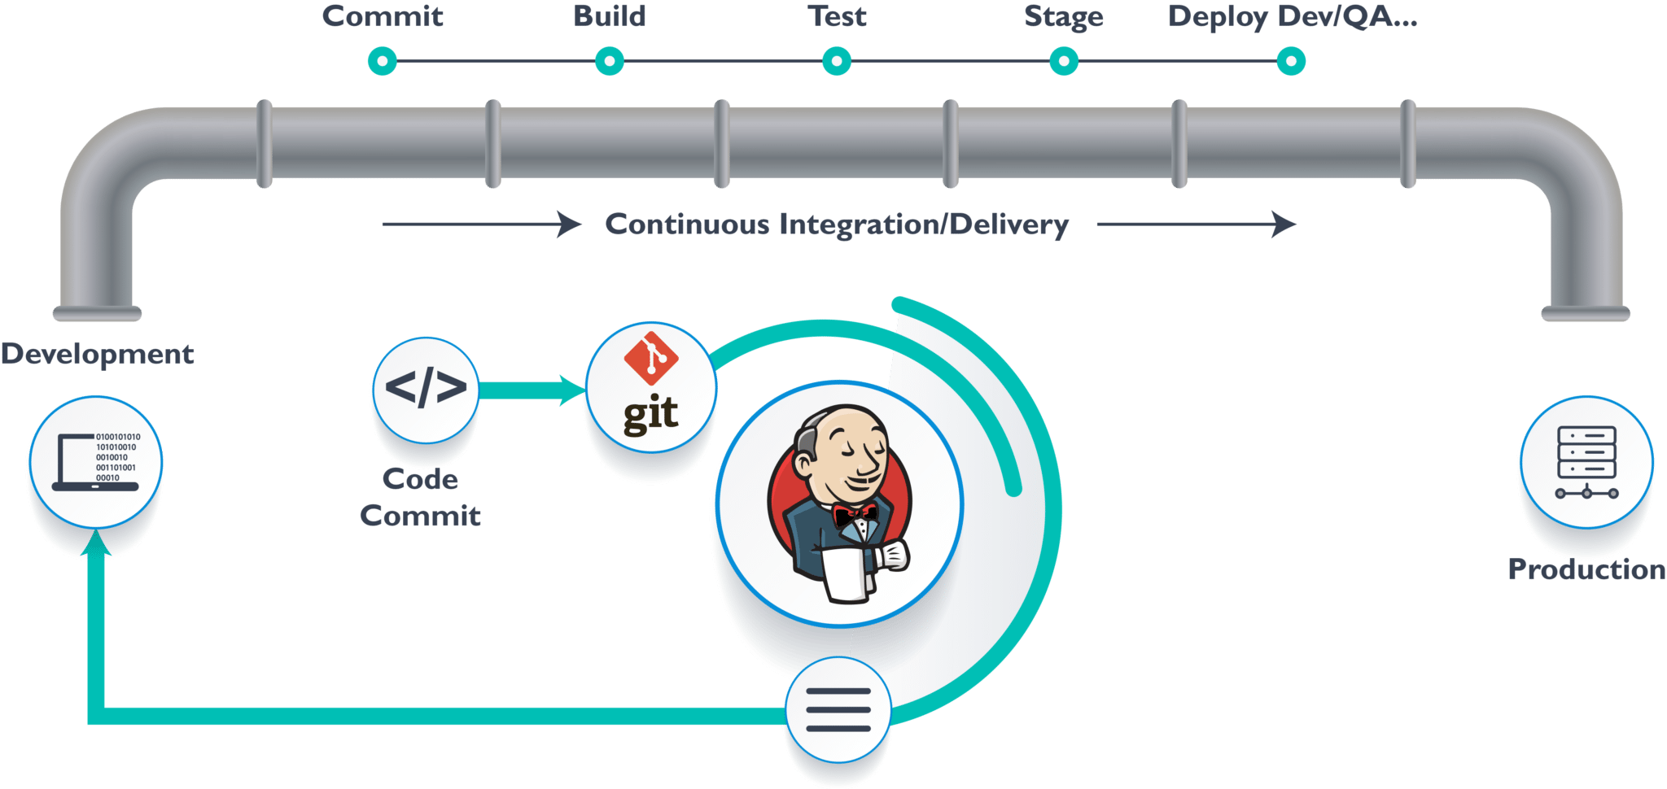
2) Use a build tool to automate workflows

